Slide 1

Face and Eye Blinking Detection System
O.D. Wedamulla
10/AS/CI/048(EP1150)
Supervisor:Ms:H.M.Rupasinghe
Department of Computing and Information Systems

Slide 2
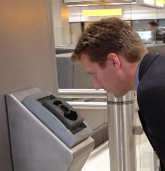
Introduction
An application Works on devices that has Android operating system and a camera.
Developed using OpenCV computer vision library
Use haarcascade XML file for detection.
Application aim – Detection of human face, eye and eye blinking
Applications
Eye recognition for security system
Replace gesture base activities

Slide 3

What is Android?
Android powers hundreds of millions of mobile devices
More than 300 hardware, software, and carrier partners
Its free- Linux based OS
Android has grown with different versions
HoneyComb(Android 3.0)
Jelly Beans(Android 4.1)
Lollipop(Android 5.0)

Slide 4

What is OpenCV?
Library of programming functions mainly aimed at real time computer vision
Developed by Intel Russia research center
Written in C++
Released under a BSD license - free for both academic and commercial use
Has C++, C, Python and Java interfaces
Has wrapper classes - use in different platforms
JavaCV – for develop in java
EmguCv – for develop in C#

Slide 5
Objectives of the Application
To provide high accurate security system by using bio metrics verification method
To provide portability for security system
To develop method to use eye as a replacement for gesture actions
To study human fatigue by analyzing data collected from face and eye detection
To enhance operability in smart watches

Slide 6

Development methodology
Windows 7 or higher operating system
Eclipse with ADT bundle
Android 4.0 or higher version SDK tools
OpenCV 2.4.9 library (executable file)
Opencv Manager
Java language
Android phone(version higher than Android 4.0)

Slide 7

Development Problems
Difficult to detect under varying lighting condition and with different people
Fixed position with artificial light
Include template that match with consecutive frame and give the output correctly- increase accuracy
Compatibility issues with different android phones from different manufactures
Check the issues regarding to phones that majority of people use
Develop according standard google APIs

Slide 8
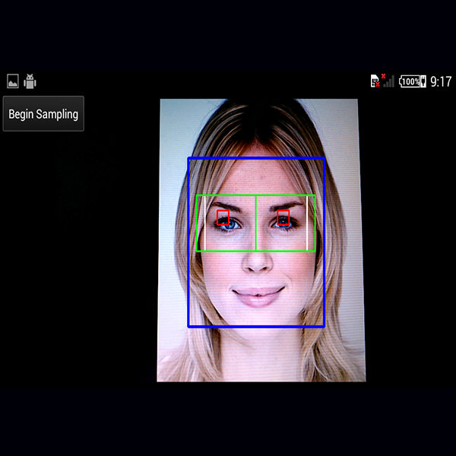
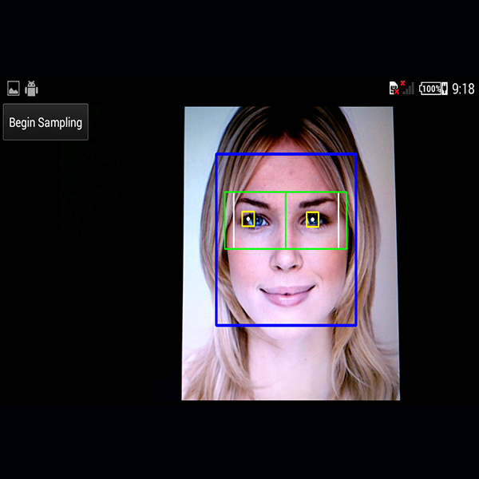
Demo
Normal eye detection
When acquiring template

Slide 9

Q & A Session

Slide 10


